Slide 1
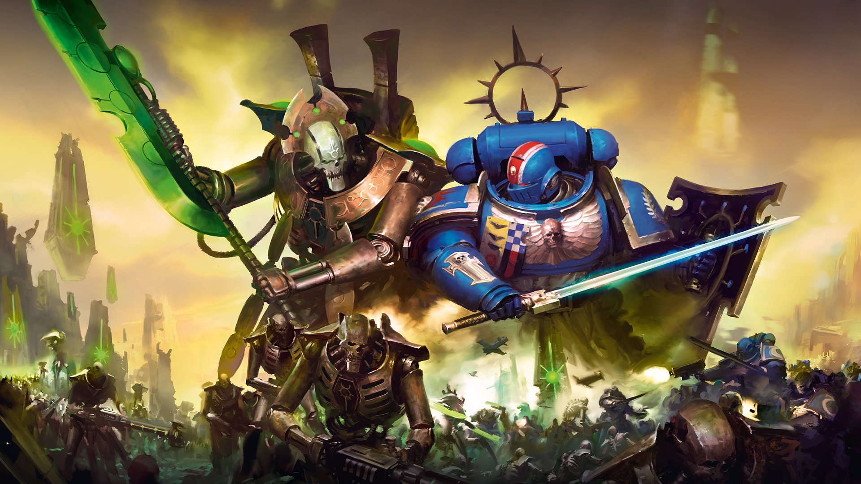
Warhammer 40'000
In the grim darkness of the far future
There is only WAR

Slide 2
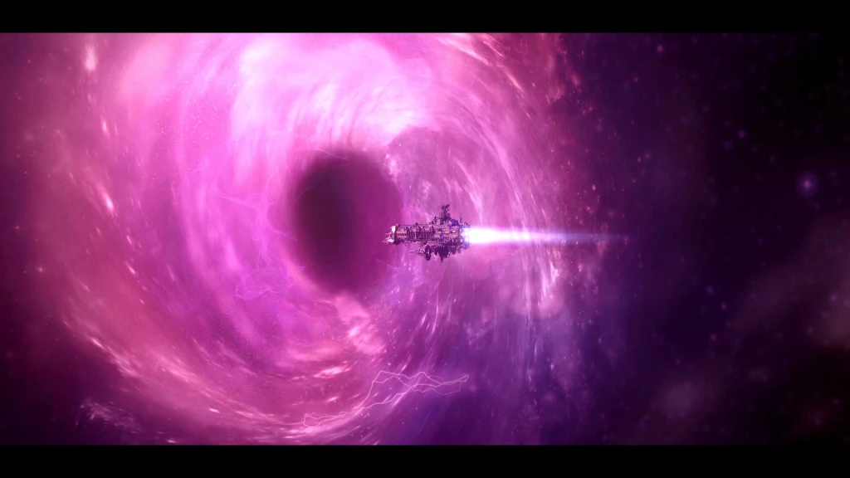
Why Machine Learning ?
A logical journey

Slide 3
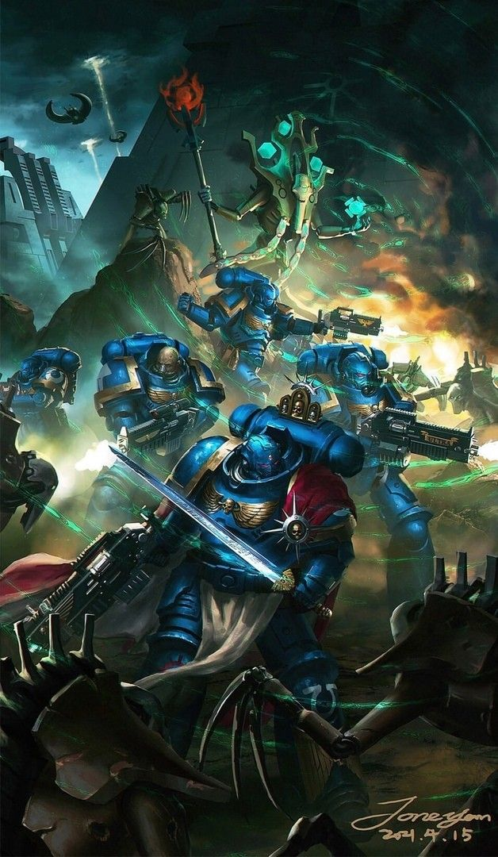
What is Warhammer 40'000 ?
1 – Turn-base Tabletop Game
- Played around a table
- Each player play alternatively
2 - Dark science-fantasy
- Set in the 41th millenium
- Every faction is evil...
- Or too stupid for that
3 – Next MCU
- The game / universe is more and more popular

Slide 4
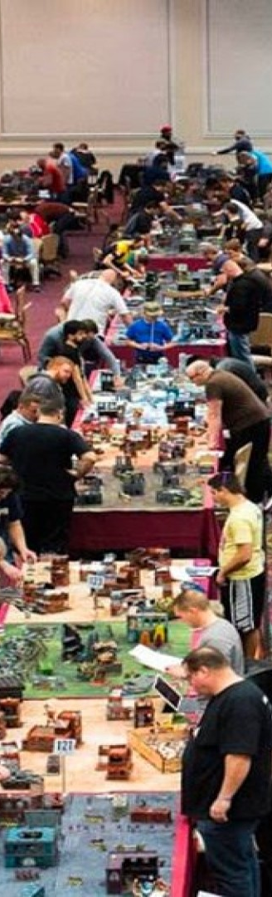
How is it played ?
1 – Army preparation
- Choose one of the 20+ factions
- Write down an army list within the agreed limit
- Collect and paint your models
2 – Meet your friend
- Reunite around a table
- Prepare the table setup
- Choose deployment and mission
3 – Play !
- Destroy your friend's army is not enough (but still satisfying)
- You must score more tactical objective points

Slide 5
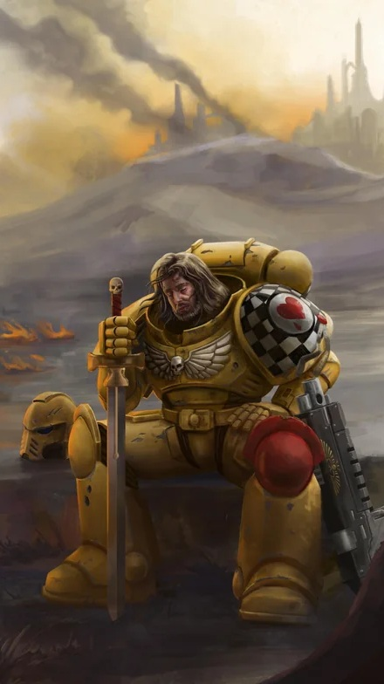
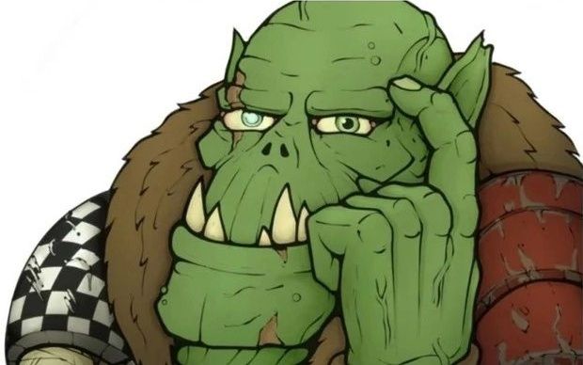
The wargamer's doom
To play a 2 players game ...
You need to be TWO !

Slide 6
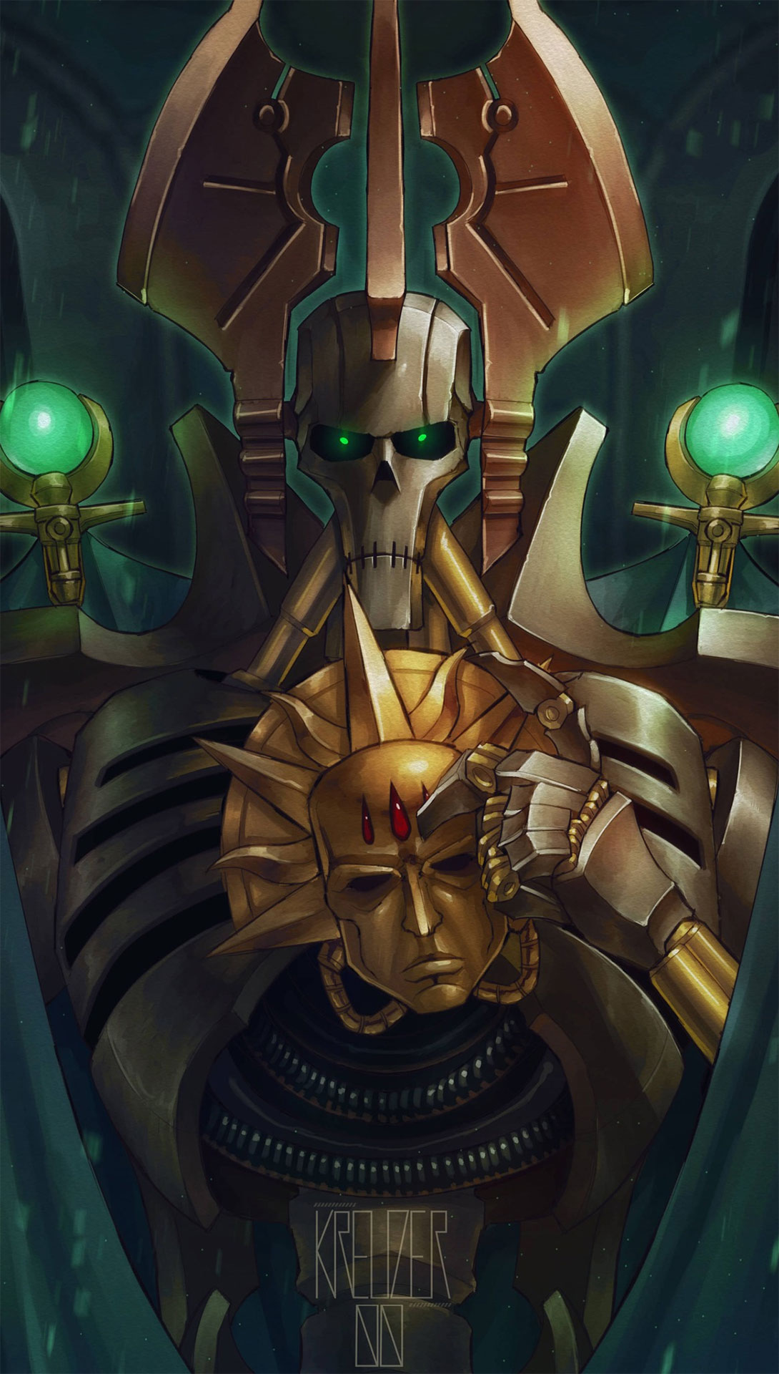
You have a new friend !
No more need of an unfaithful human to play !
Welcome the Reinforcement Learning AI !!
Say hello to Q-Learning !!!
A friend for life

Slide 7

Technical solution
Make it real
Frontend : React
WARHAMMER 40K GAME REQUIREMENTS
- Complex Board State Management:
- Handles 142-element observation vectors
- Unit positions
- Real-time UI Updates without full re-renders :
- React's virtual DOM efficiently updates hex highlights
- Unit HP bars
- Phase indicators
Component Hierarchy:
- Game board → hexes → units → HP bars maps naturally to React component tree
Event Handling: Click events for
- movement, shooting, charging require sophisticated event delegation React provides
PERFORMANCE CONSIDERATIONS
- PIXI.js Integration:
- React manages PIXI.js canvas lifecycle while PIXI handles WebGL rendering for smooth 60fps board updates
- TypeScript Compatibility: Strong typing prevents AI_TURN.md field name violations at compile time
- Bundle Size: React 19.1.1 + PIXI.js-legacy 7.4.3 totals ~500KB gzipped - acceptable for strategy game

Slide 8

Technical solution
Make it real
Backend : Python
OBVIOUS CHOICE
- Only viable option for serious deep reinforcement learning with SQN training
FAMILIARITY
- I have made almost all the ML training on Python

Slide 9

Technical solution
The drama
Architecture conflict !
After 3 months of work, I had achieved :
- Complete PvP mode
- Fully functional training
Time to play versus the AI !?
I quickly realized a major flaw in my architecture :
I made the PvP management led by React (click reactive)
The AI was led by Python, obviously.
They could NOT work together !!!
I had to restart ALL the prject from scratch....

Slide 10
Technical solution
Mind your own business
Architecture Alignment
BACKEND (ENGINE) DRIVES:
- Sequential unit activation: Engine selects next eligible unit
- Phase transitions: Engine determines when phases end by eligibility
- Step counting: Built-in episode_steps in single location
- Game state authority: Single game_state object in engine
- AI decision making: DQN predictions happen in engine
- Action validation: Engine validates all moves/shoots/charges
FRONTEND (REACT) DISPLAYS:
- Visual representation: PIXI.js renders current game_state
- User input collection: Captures human player clicks/selections
- State reflection: Shows what backend engine determines
- Animation/UX: Smooth transitions between backend state updates
Clear Boundary:
Backend Engine drives ALL game logic → Frontend displays current state only

Slide 11
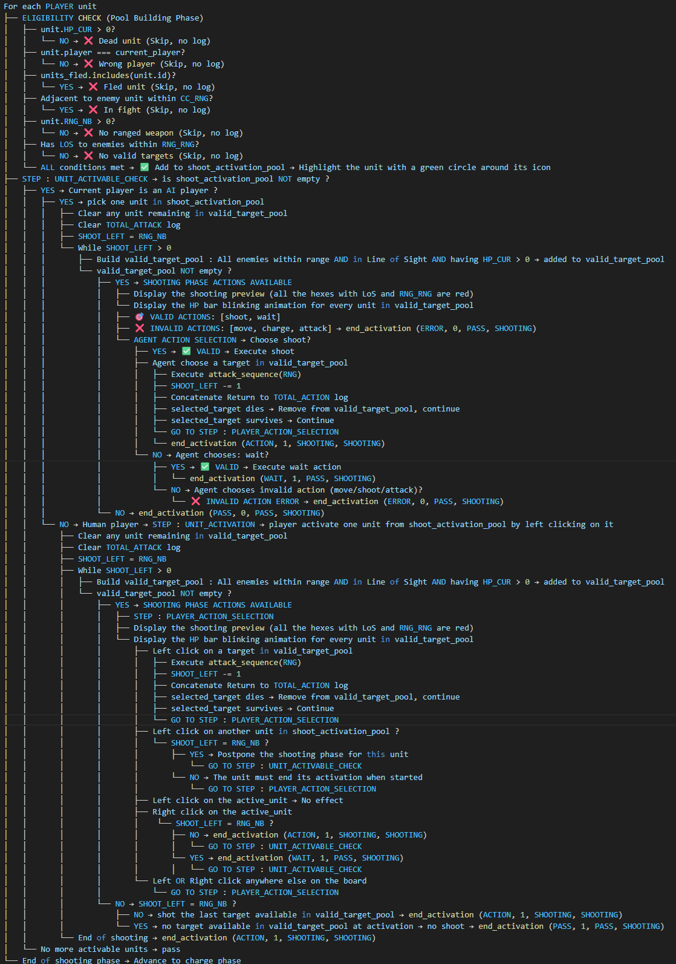
Preparation Work
Make the game follow the Warhammer rules
This « algorythm » describes the way the shooting phase should be played

Slide 12
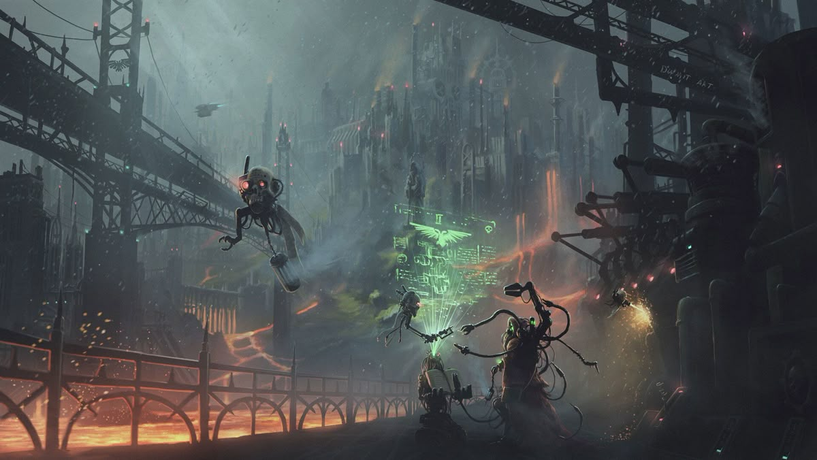
Back to the AI

Slide 13

What is Q learning ?
Overview
You are playing a new video game… with no tutorial!
- You press buttons randomly.
- Sometimes you score points (reward).
- Sometimes you fail (oops, lesson learned...).
Over time, you learn what works and what doesn’t.
This is the way Q-Learning works
- A machine (aka the Agent) learns by interacting with the world (aka the Environment).
- It tries things out, gets feedback, and improve over time.

Slide 14
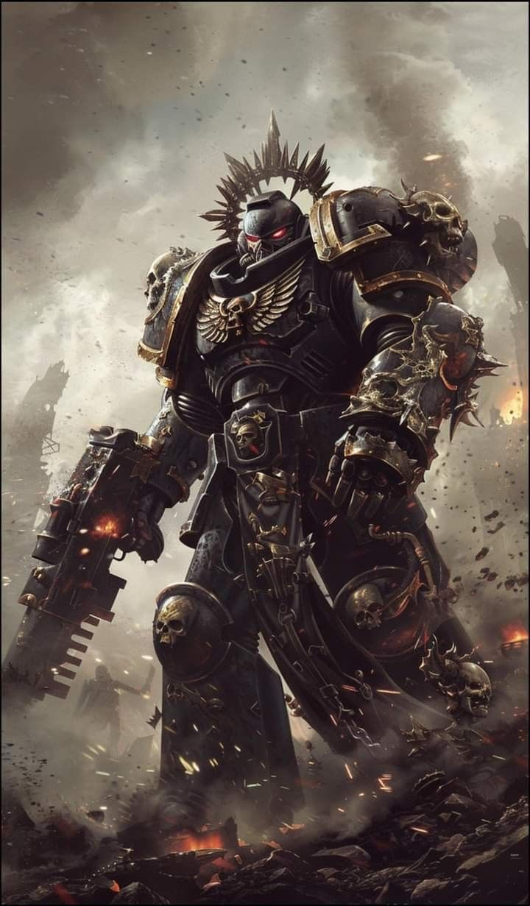
How to help Bob to survive ?
Q learning to the rescue !
Bob’s Learning Steps
Step 1: See where you are
→ "Am I near a Bloodthirster? An objective ? A wall?"
Step 2: Pick a move
→ "Do I go left, right, up, or down?"
Step 3: Get feedback
→ "Did I get points?" ✅ (Good move!)
→"Did I get eaten?" ❌ (Bad move!)
Step 4: Update memory
→ "I should do this more often… or never again!"
Over time, Bob remembers what works best and makes better choices!
(think Edge of tomorrow)

Slide 15
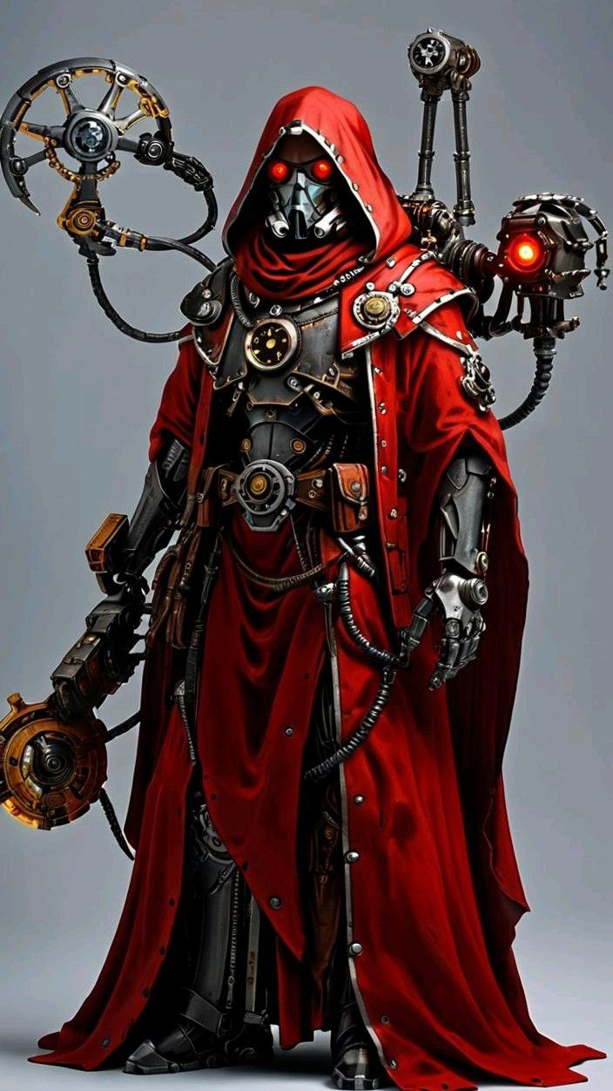
The Formula
Q(s,a)=Q(s,a)+α[r+γmaxQ(s′,a′)−Q(s,a)]
Q(s, a) → The current guess for how good the action (a) in this state (s) is
α → How fast he updates what he knows
r → Reward
γ → How much we value current over future rewards
max Q(s', a') → The best future reward he can expect
This function will return how good is it to be in the state s and take an action a in this state

Slide 16

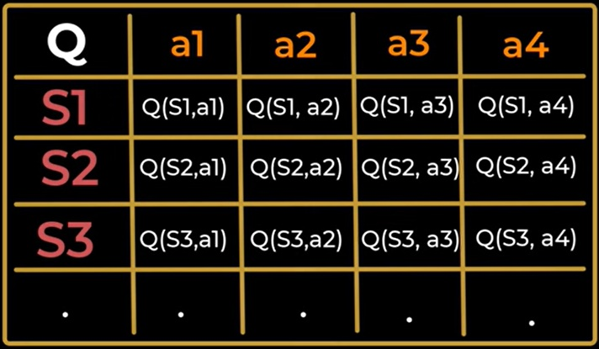
The Q table
Think of Q-values as Bob’s personal cheat sheet
v
Goal : Update and learn these q values such as the total reward is maximized

Slide 17
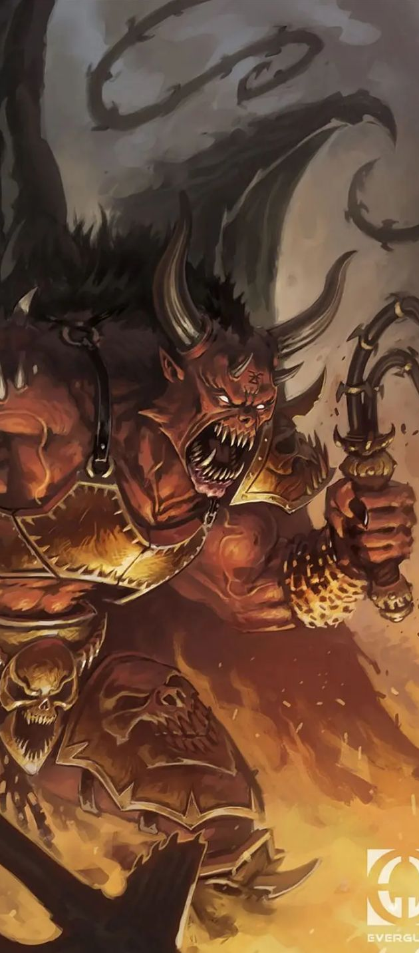
Learning parameters
Learning Rate (α) : How fast Bob adapts?
- Learns too fast : »I got killed going left once. Never going left again! »
→ Changes mind too quickly
- Learns too slow : "I keep dying, but the demon on the left may be shy?"
→ Keeps making the same mistakes
✅ Smart Bob? Remembers key lessons but still adapts
Future Discount (γ) : Thinking Long or Short-Term?
- Short-term: "Rush the secondary objective now!"
→ Misses big rewards.
- Long-term: "Go for the primari objective!… oh no, I got killed first!"
→ Waits too long & loses
✅ Smart Bob? Balances small wins & big rewards
This is a Bloothirster

Slide 18
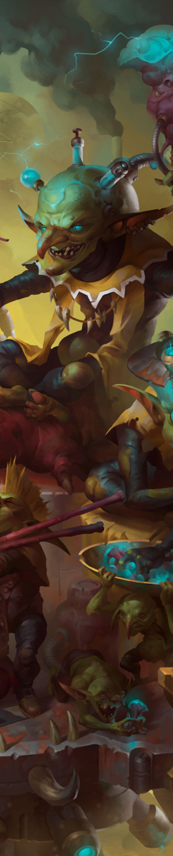
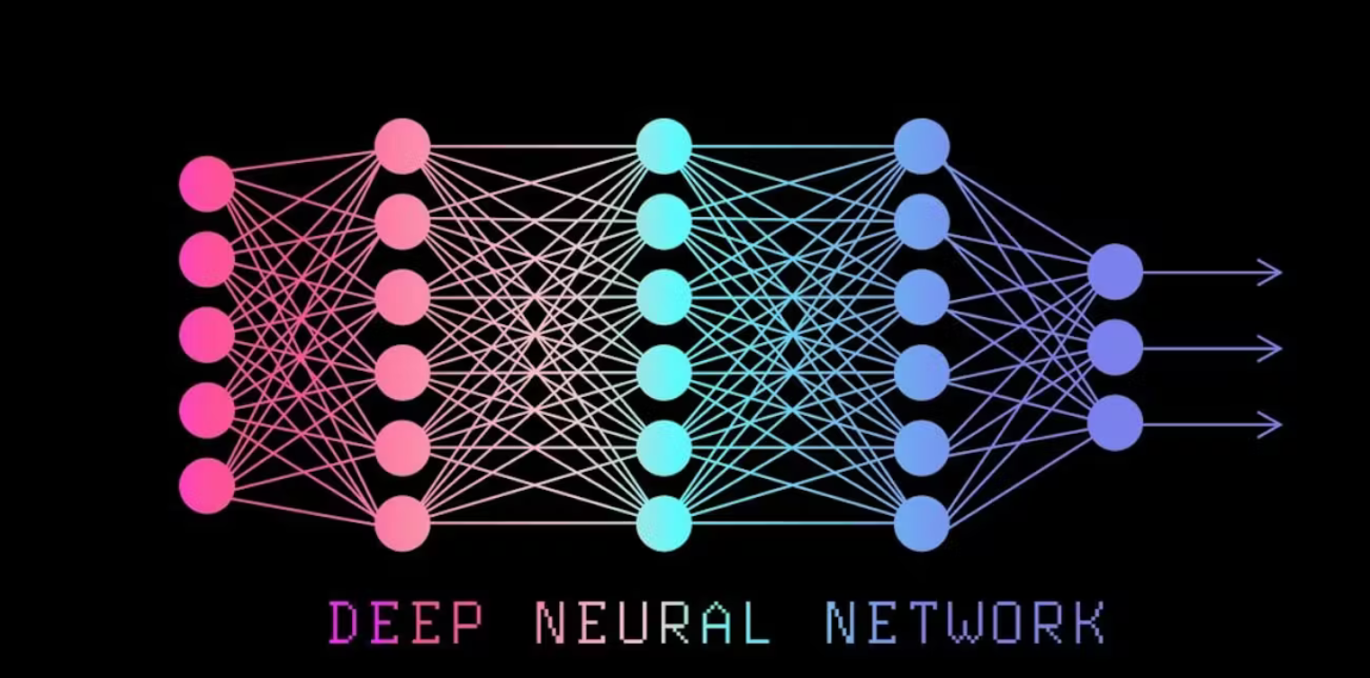
Into the code
How does Bob decides what to do ?
(Enter Bob's brain)
Observation
Hidden Layers
Actions
142
8

Slide 19
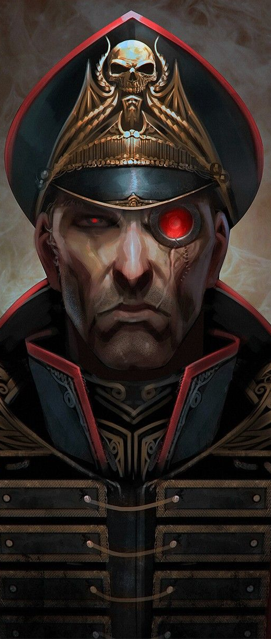
Observation
How Bob knows his environment ?
DQN Input
142 positions array :
- Position 0 : Current player (0 or 1)
- Position 1: Game phase encoded as decimal
- Position 2: Turn number normalized (divided by 10, capped at 1.0)
- Position 3: Episode steps normalized (divided by 100, capped at 1.0)
- Positions 4-141: data for 1 unit (11 numbers x 10 units)
Each unit's 11 numbers represent:
- Normalized X position (col/board_width)
- Normalized Y position (row/board_height)
- Health ratio (HP_CUR/HP_MAX)
- Has moved flag (0.0 or 1.0)
- Has shot flag (0.0 or 1.0)
- Has charged flag (0.0 or 1.0)
- Has attacked flag (0.0 or 1.0)
- Normalized range (RNG_RNG/24.0)
- Normalized damage (RNG_DMG/5.0)
- Normalized melee damage (CC_DMG/5.0)
- Alive flag (always 1.0 since dead units filtered out)

Slide 20
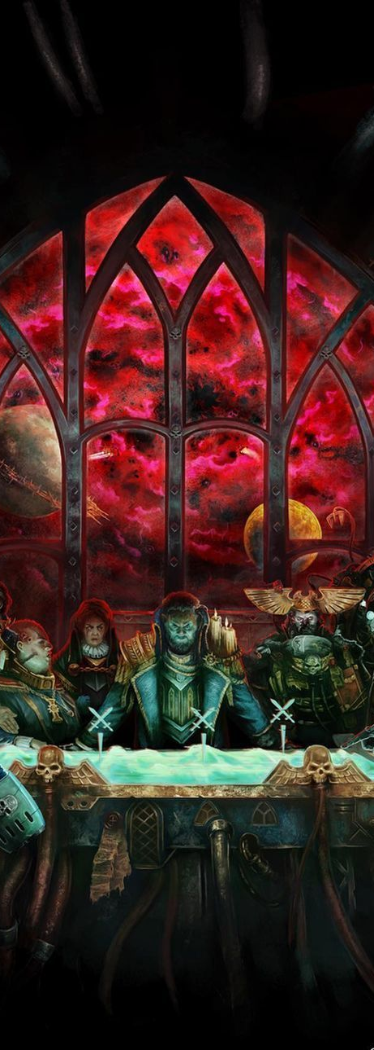
Tailor Strategy
How Bob learns to play ?
Exploration
What if I go left ?
Estimation
I should get +2 Reward
Adjustment
Reality check
Bob get +2 for moving left...
But also -5 for being shot !

Slide 21
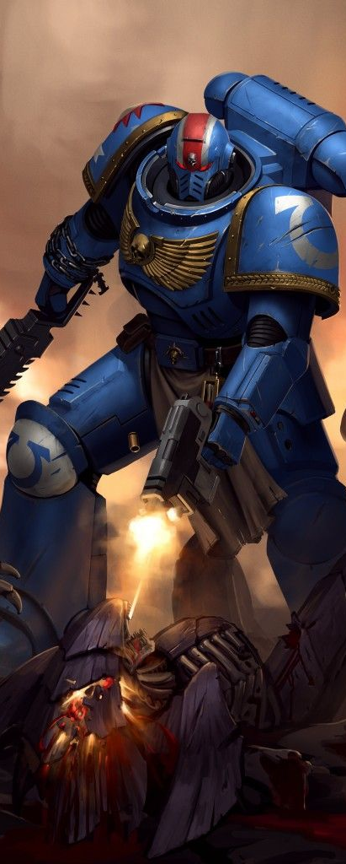
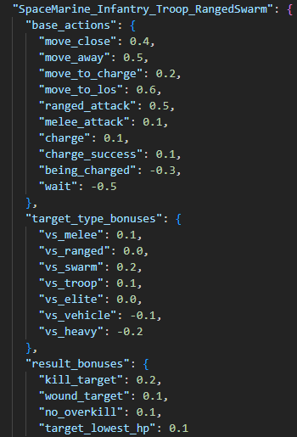
Rewards
How Bob knows if he is doing good ?

Slide 22
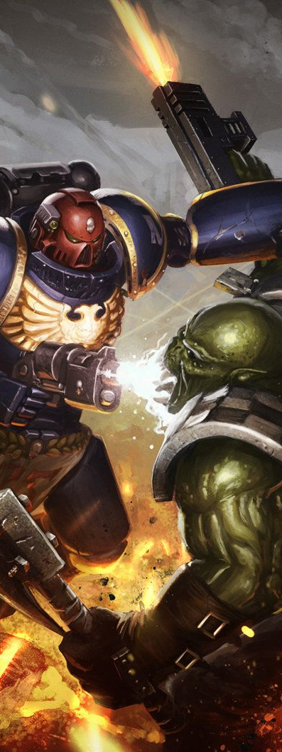
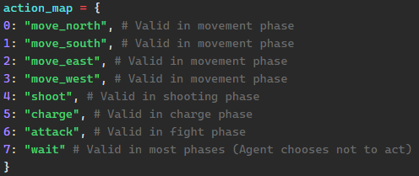
Make a Choice
What can Bob decide to do ?
DQN Neural Network
Input Layer: 142 neurons (observation vector)
↓
Hidden Layer 1: 64 neurons (ReLU activation)
↓
Hidden Layer 2: 64 neurons (ReLU activation)
↓
Output Layer: 8 neurons (Q-values for actions 0-7)
↓
Action taken : Action with the highest Q-value

Slide 23
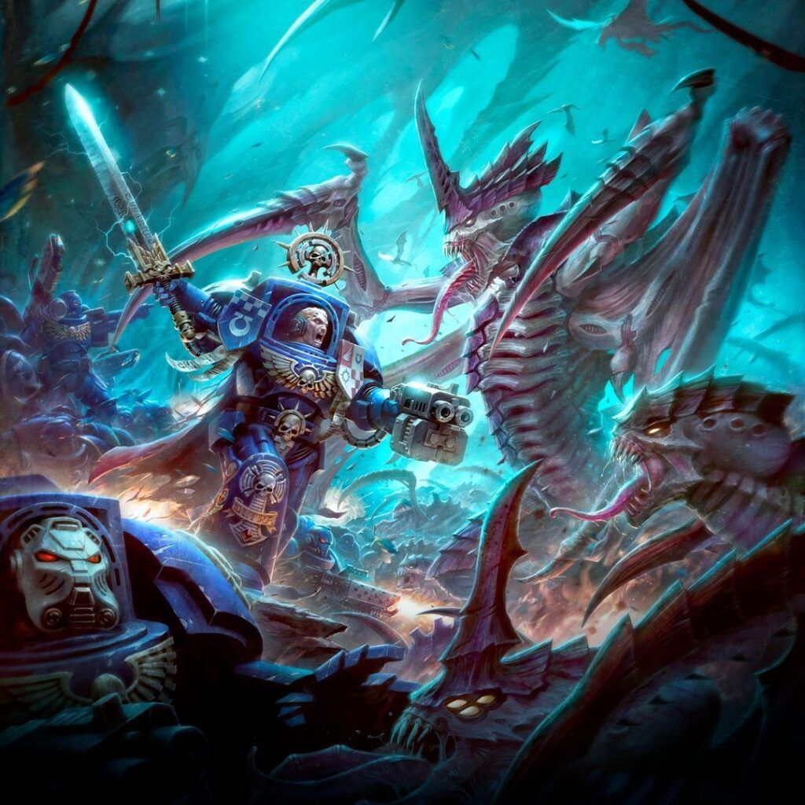
Let's Playyyy !!!

Slide 24
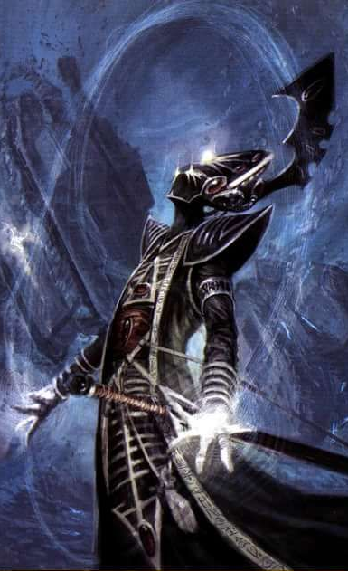
Future improvements
1 - Finish the game's core
- Add the charge and combat phases
2 – Upgrade Observation
- Add tactical datas to let him decide what to shoot
3 – Optimize the agent training
- Make it worth playing against
4 - Add new units
- Assault Intercessors, Captain Gravis....
5 - Add new factions
- Tyranids, Orks, etc...
6 - Share the game !

Slide 25
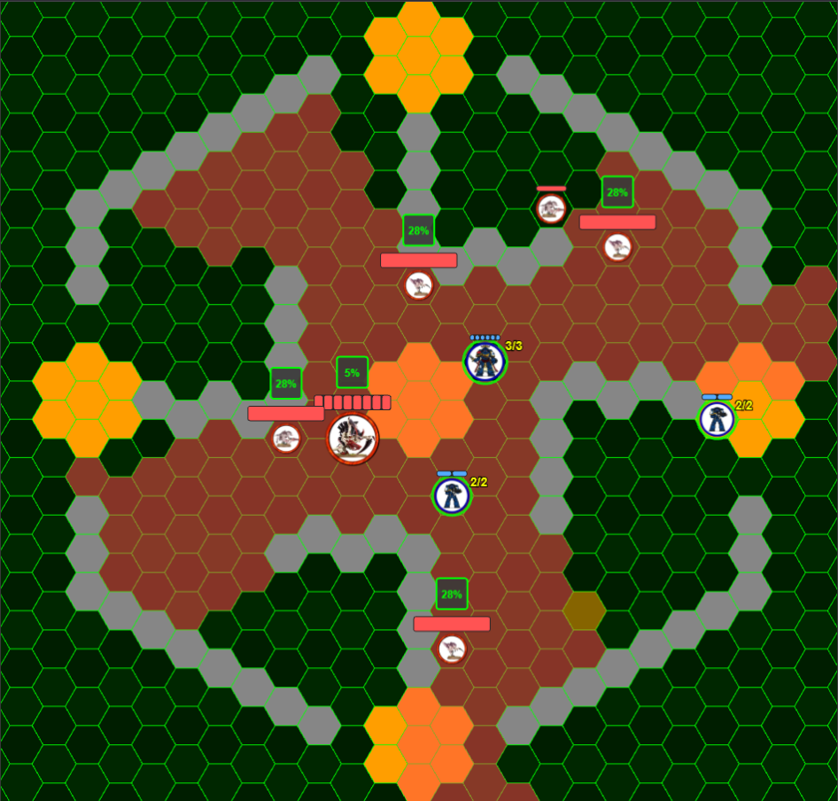
Future sample
Tactical Objectives
New Marins Unit :
Captain Gravis
New Faction : Tyranids
Tyranids Unit :
Carnifex
Hormagaunt
Termagant

Slide 26
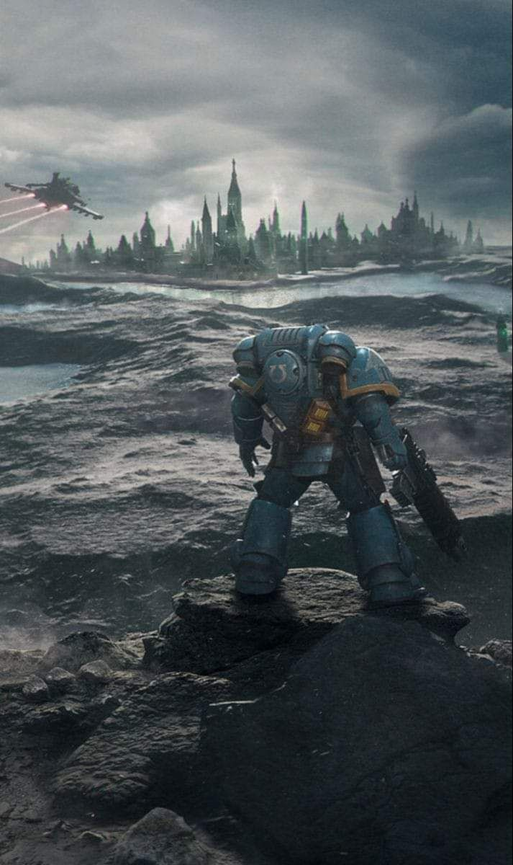
My Future
Find a first job in AI
…
Anywhere in the galaxy !
(and keep learning)

